Slide 1


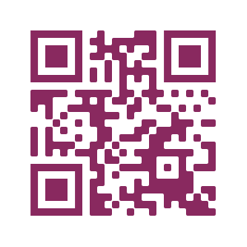
MORE ON SUICIDE SAFER CARE
Simple Steps to Help Save Lives: Practical Suicide Prevention Strategies for Primary Care Professionals in Training
Find more resources, including our Quick Tips Guide for Healthcare Professionals in Training, Suicide Safer Care toolkits, archived webinars, and more on our website:
bit.ly/suicidesafer

Slide 2
Strengthening the Connection: Primary Care & Suicide Prevention
VIRNA LITTLE, PsyD,
Concert Health, Co-Founder and CCO

Slide 3
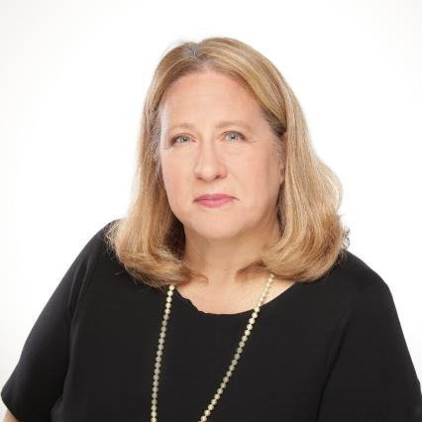
Faculty/Presenter Disclosure
Speaker: Virna Little, PsyD, LCSW
Relationships with financial sponsors:
  Grants/Research Support: N/A
  Speakers Bureau/Honoraria: Yes
  Consulting Fees: N/A
  Patents: N/A
  Other: N/A
Notes:
Please complete the parts in RED – disclose any COI

Slide 4

Suicide Experiences
Suicide experiences are not uncommon. Each year:
  10 million American adults think seriously about killing themselves
  3 million make suicide plans
  1 million make a suicide attempt
Substance Abuse and Mental Health Services Administration. HHS Publication No. (SMA) 13-4795 2013

Slide 5
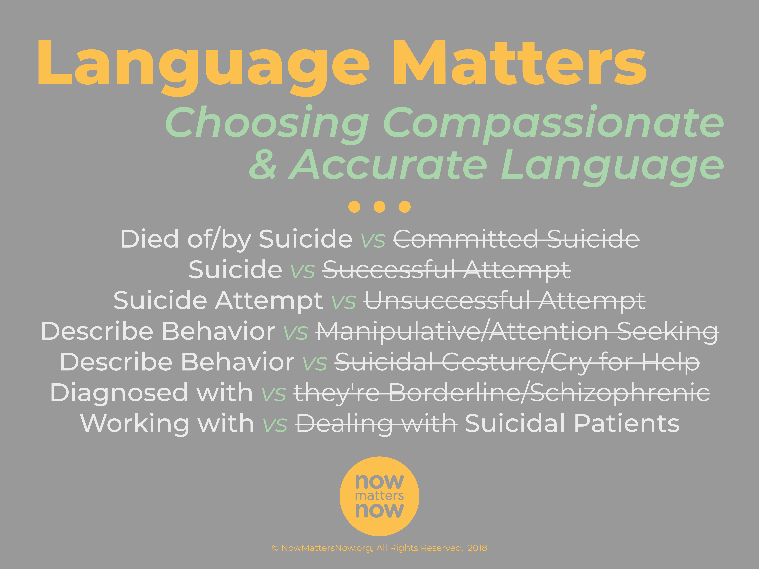

Slide 6

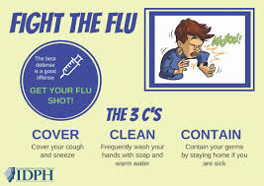
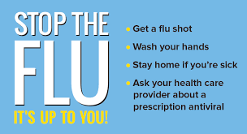



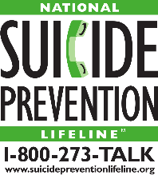
Outline
2018 deaths among all ages
  Influenza and pneumonia: ~55,000 deaths a year = 150 per day
    Among 10 to 24-year-olds: ~241 deaths a year = 4 per week
  Motor vehicle accidents: ~39,000 deaths = 108 deaths a day
    Among 10 to 24-year-olds: ~7,000 deaths = 19 deaths a day
  Suicide: ~ 48,000 deaths = 132 deaths a day
    Among 10 to 24-year-olds: ~ 6,800 deaths = 18 deaths a day
CDC, 2018
Zero Suicide | zerosuicide.edc.org

Slide 7
Why Focus on Health Care Settings?
84% of those who die by suicide have a health care visit in the year before their death.
92% of those who make a suicide attempt have seen a health care provider in the year before their attempt.
Almost 40% of individuals who died by suicide had an ED visit, but not a mental health diagnosis.
Luoma, J.B., Martin, C.E., & Pearson, J.L. (2002). Contact with mental health and primary care providers before suicide: A review of the evidence. American Journal of Psychiatry, 159(6), 909-916..

Slide 8

Geriatric Patients and Suicide Risk
15% of older adults are affected by depression
30% of older adults do not get care or treatment
18% of suicides are an older adult, one every 90 minutes

Slide 9

Youth Suicidal Behavior and Ideation
2019 Youth Risk Behavior Survey (YRBS)
  8.9% of high school students attempted suicide one or more times in the past year
  18.8% of high school students reported “seriously considering attempting suicide” in the past year
CDC, 2019
Adolescent Suicide Prevention and Medical Settings
Zero Suicide | zerosuicide.edc.org

Slide 10
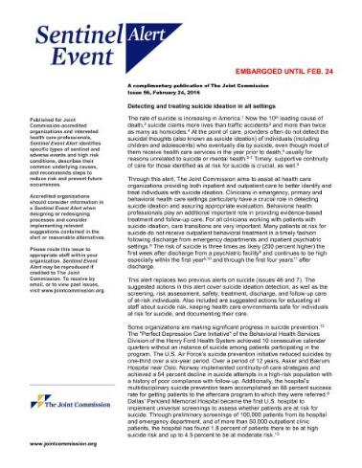
Joint Commission Sentinel Event Alert 56
The suggested actions in this alert cover suicide ideation detection, as well as the screening, risk assessment, safety, treatment, discharge, and follow-up care of at-risk individuals. Also included are
suggested actions for educating all staff about suicide risk, keeping health care environments safe for individuals at risk for suicide,
and documenting their care.”

Slide 11
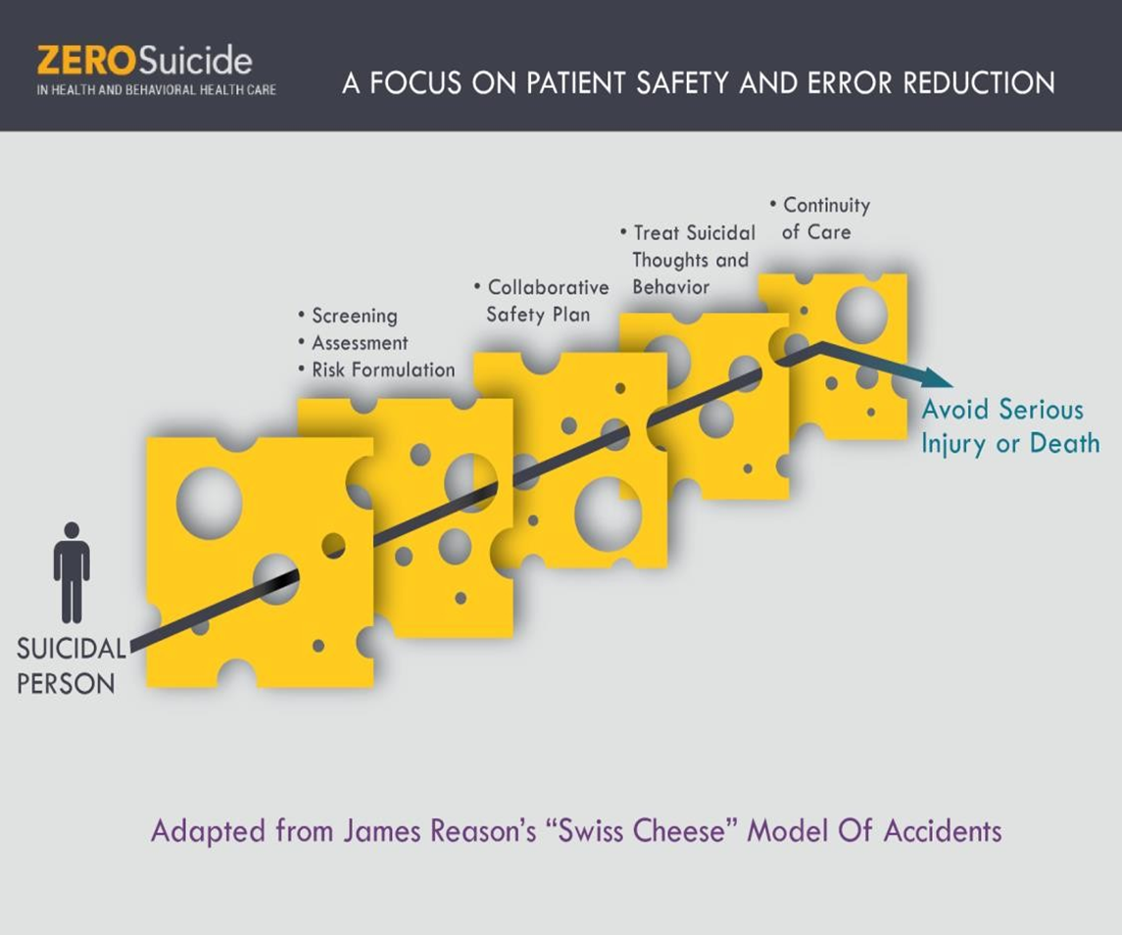
Patient Safety and Error Reduction

Slide 12
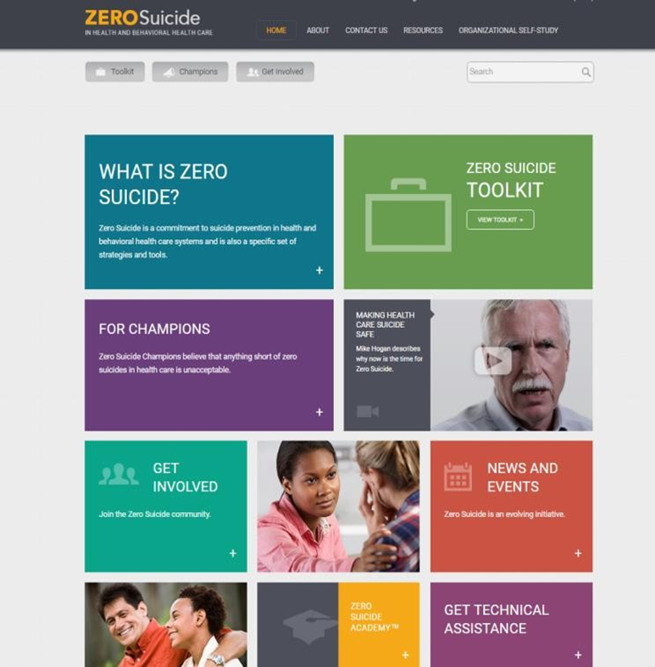
Zero Suicide
Access at:
www.zerosuicide.com

Slide 13
What We Hear Sometimes…
“I don’t have the knowledge to assess or intervene.”
“With such a short amount of time, I don’t have time to ask or address suicide risk.”

Slide 14
The Minimum How (to do it)
In Your Office
Do not panic.
Be present listen carefully and reflect)
Provide some hope
Ex. “You have been through a lot; I see that strength”
3 things that suicidal people want
LANGUAGE MATTERS!

Slide 15
Identification
Many offices are screening for depression
Ask patients directly (ask what you want to know)
Social determinants play a role
Many patients don’t have depression
Substance and alcohol use play a role
Transitions are a time of risk

Slide 16
Population of Patients at Risk for Suicide
Do you know how many are in your on your panel, in your practice or organization ?
Are you adding ICD10 codes to your problem list ?
Do you have expectations/standards for BOTH newly identified patients and patients following up for routine primary care ?
What does excellent care for patients at risk for suicide in your organization look like ?

Slide 17
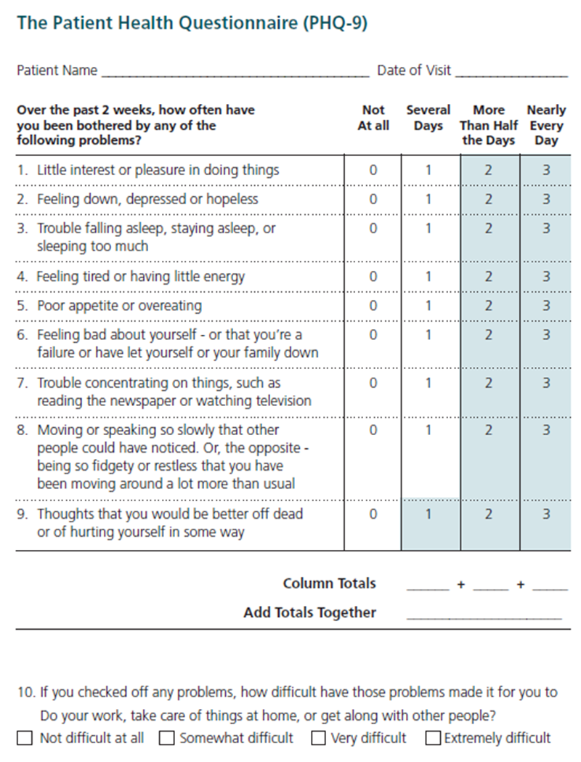
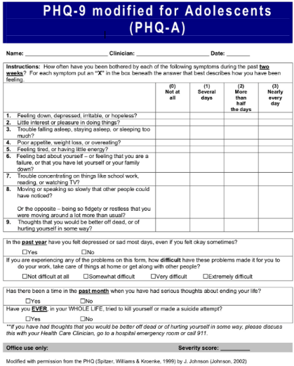
The Patient Health Questionnaire (PHQ-9)

Slide 18
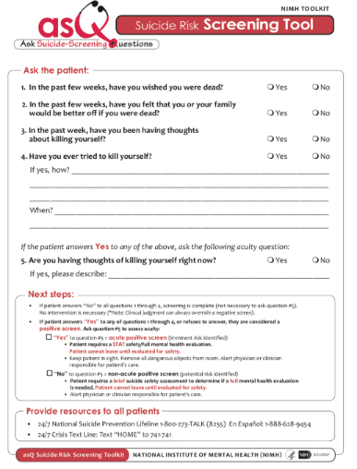
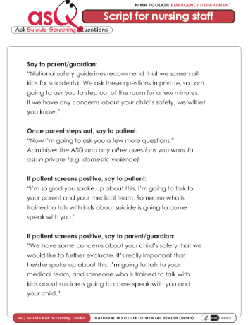
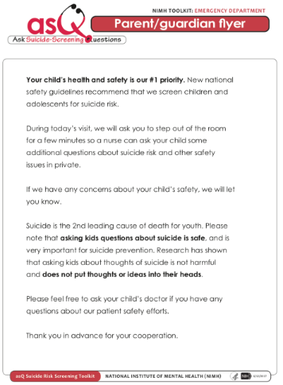

Slide 19
Appropriate Levels of Care
* Not everyone needs an alternate level of care
* There is no “emergency room “ magic

Slide 20
Assessing Risk
Can and does happen in primary care settings-appropriate level of care
Helpful to speak the same language and understand the assessment process
The primary care visit focus becomes the risk for suicide

Slide 21
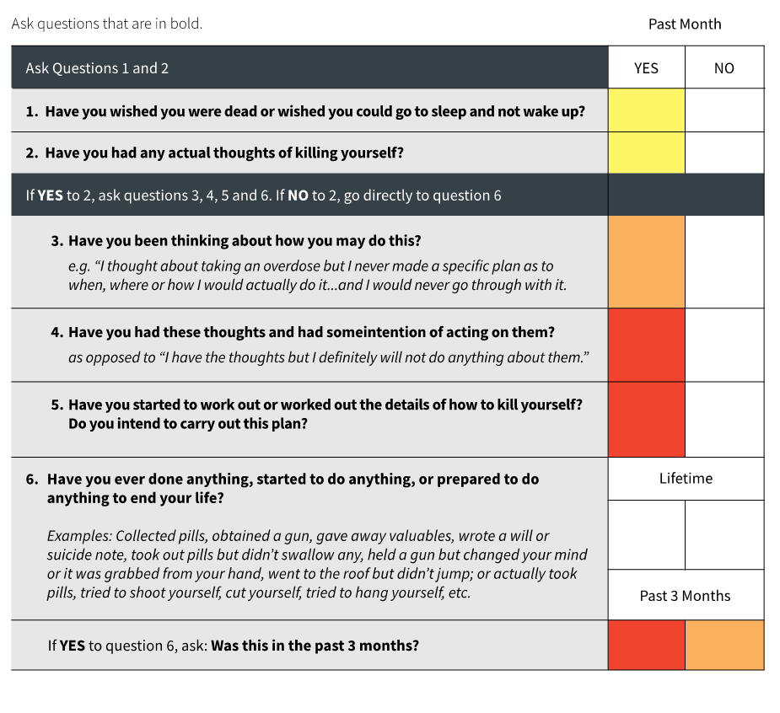
Response Protocol
Schedule follow-up
Address Lethal Means, Safety Planning, Schedule Follow-up
Evaluate Hospitalization, Address Lethal Means, Safety Planning, Schedule Follow-up

Slide 22
Protective Factors
What are reasons you would not die by suicide today ?
Some common protective factors:
Kids
Family/spouse/parents
Pets
Religion
Job

Slide 23

What is Safety Planning?
Safety Planning Intervention consists of a written, prioritized list of coping strategies and sources of support that patients can use to alleviate a suicidal crisis.

Slide 24


Discussing the Columbia (continued)
The
Minimum
WHAT
(to
do)
BEFORE THEY LEAVE YOUR OFFICE
•Suicide Prevention Lifeline or Crisis Text Line in their phone
–988
•Address guns in the home and preferred method of suicide
•Give
them
a
caring
message
(NowMattersNow.org  “More”)
NowMattersNow.org ©2018 All Rights Reserved

Slide 25
NowMattersNow.org
Works
Website visits are associated with
decreased intensity of suicidal thoughts
and negative emotions.
This includes people whose rated their
thoughts as “completely overwhelming”
NowMattersNow.org ©2018 All Rights Reserved

Slide 26
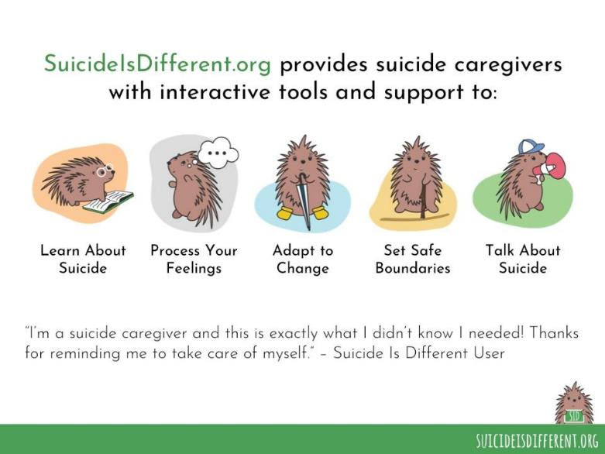

Slide 27
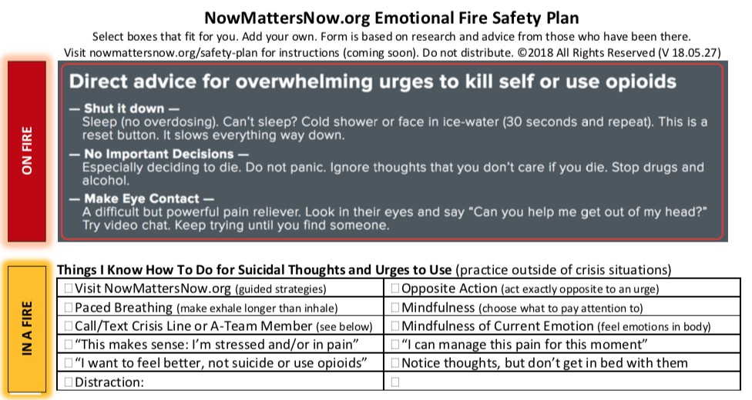
Safety
Plan
NowMattersNow.org ©2018 All Rights Reserved

Slide 28
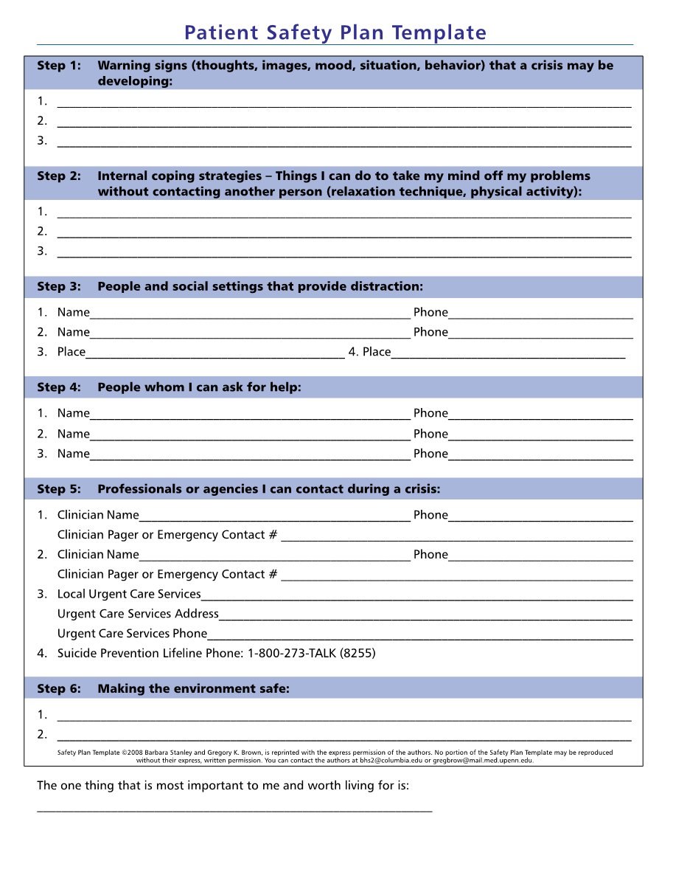
Patient Safety Plan

Slide 29
Safety Planning
Can the activity happy all times of the day and all times of the year
Call someone from the patient's team “Sarah and I would like to speak with you, she has listed you on her suicide safety plan.”
Be creative – Walmart!
How can we keep you safe today ?

Slide 30
Lethal Means Restriction
Temporary
Matter of Fact
Standard Practice
Safety Approach (Public Health!)
Preferred method is important to know and note

Slide 31
Lethal Means
How much medication is in your home? (neighbors, family)
Medication boxes, family, individual wrapping, “pill packs”
Gun locks, boxes, family or surrender for holding
The time to talk to the pharmacy is now ……….

Slide 32
Caring Contact
Henry,
I don’t know you well yet, I am glad that you told me a little more about your life. I have lots of hope for you – you’ve been through a lot. I hope you’ll remember that and come back to see us. With care, -Nurse Matt

Slide 33
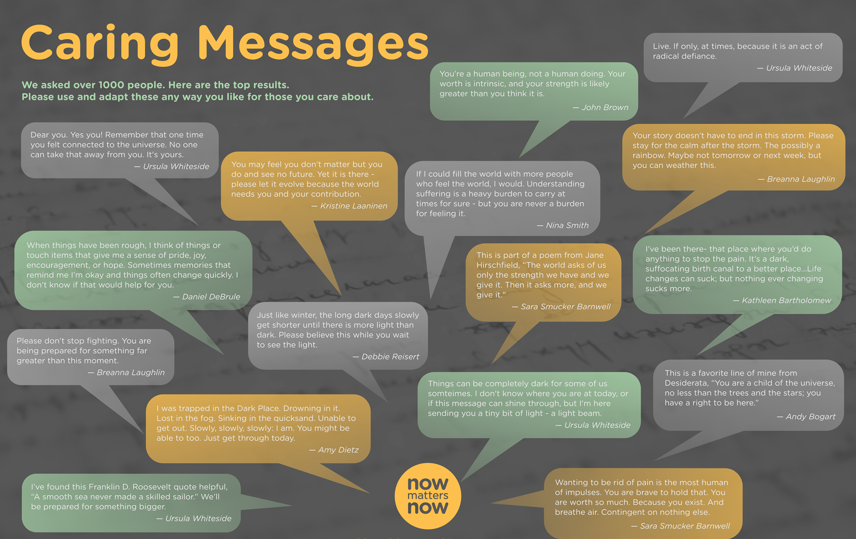
Caring Messages

Slide 35
Virna Little
virna@concerthealth.io

